Slide 1
Dementia Detection using Various Classification Methods
Team Members:
A. Akshitha - 18071A0502
Ch. Sankranthi - 18071A0510
K. Sravya - 18071A0527
S. Shanmukha Anurag - 18071A0551
Guide:
Dr. B. V. Kiranmayee
Professor
VNRVJIET

Slide 2
AGENDA
ABSTRACT
INTRODUCTION
LITERATURE SURVEY
EXISTING SYSTEM
PROPOSED SYSTEM
SYSTEM REQUIREMENTS
SYSTEM ARCHITECTURE
MODULES
UML DIAGRAMS
IMPLEMENTATION
RESULT
CONCLUSION
FUTURE SCOPE
REFERENCES

Slide 3
ABSTRACT
According to the World Health Organization (WHO), dementia is “an umbrella term for several diseases affecting memory, and behavior that interfere with a person's ability to maintain their daily living activities. It is not a normal part of aging”.
Dementia is caused by physical changes in the brain. Many different diseases can cause dementia. Drugs are available to alleviate some of the symptoms, but they do not cure it.

Slide 4
ABSTRACT
Alzheimer's is the most common type of dementia, but there are many kinds. Dementia is best characterized as a syndrome rather than as one particular disease.
The causes of dementia are myriad and include primary neurologic, neuropsychiatric, and medical conditions. It is common for multiple diseases to contribute to any one patient's dementia syndrome.

Slide 5
INTRODUCTION
Alzheimer’s disease accounts for 60 to 80 percent of cases. But, there are many other conditions that can cause symptoms of dementia, including some that are reversible.
Memory problems are common but they can be an early sign of a medical condition such as dementia.
Many people notice that their memory becomes less reliable as they get older, but other factors like side effects of medications may be a reason.

Slide 6
INTRODUCTION
Dementia can be caused by many conditions such as primary neurologic, neuropsychiatric, and medical conditions.
A person diagnosed with dementia may struggle to remember recent events, but they can easily recall past events.
They tend to forget the names of friends or everyday objects, lose thread of what they are saying and feel confused even when they are in a familiar environment.

Slide 7
LITERATURE SURVEY
S.No. | Title of the Paper | Methods | Pros/Cons | Year
1 | Using Machine Learning to Predict Dementia from Neuropsychiatric Symptom and Neuroimaging Data | Alzheimer’s Disease Neuroimaging Initiative data set, Clinical MRI data, Statistical Analysis, Feature Selection and Classification. | Cons: Focuses on only single Image Modality which results in low accuracy, substantial error measurement found in mild behavioral impairment positive (MBI+), one of the factors for dementia. Pros: Techniques would be helpful in early detection of dementia. | 2020
2 | Machine Learning for the Preliminary Diagnosis of Dementia by Fubao Zhu, et al. | Random Forest, AdaBoost, LogitBoost, Neural Network, Naive Bayes, and Support Vector Machine | Cons: The study was conducted only in three hospitals, which may show selection bias. More subjects are needed to validate the method. | 2020
3 | Machine Learning Techniques to Identify Dementia by Shanta R | Support Vector Machine, Linear Discriminant Analysis and K-Nearest Neighbour Algorithms | Pros: The techniques diagnosis of disease at early stages but a larger dataset can be used to obtain more accuracy. | 2020
4 | Spatiotemporal formal extraction and classification of Alzheimer’s disease using deep learning 3D-CNN for fMRI data | fMRI and deep learning techniques, 3D CNN data extraction and classification steps | Cons: fMRI technique needs to be developed for this problem statement, more training of CNN model is required, each kernel type has its own limitations and advantages which doesn’t make one superior over the other. | 2020

Slide 8
LITERATURE SURVEY
S.No. | Title of the Paper | Methods | Pros/Cons | Year
5 | Applying Deep Learning to Predicting Dementia | Deep Learning based on the ADNI (Alzheimer’s Disease Neuroimaging Initiative) data. | Cons: Deep Learning requires more sophisticated data pre-processing and feature engineering, as well as much more computational time for training a single model in comparison to statistical implementations. | 2020
6 | A Machine Learning Approach for the Differential Diagnosis of Alzheimer and Vascular Dementia Fed by MRI Selected Features | Image Processing using FSL tool and Matlab, Tract based spatial statistics on DTI images in FSL tools. Brain Network and Graph Metric Computation, Artificial Neural Network and Support Vector Machine, Neuro Fuzzy System. | Multiple ML techniques were used to detect Alzheimer's dementia (AD), Vascular dementia (VD) and Mixture of both (MXD) to obtain around 84% accuracy for AD. | 2020
7 | Machine Learning technique for the diagnosis of Alzheimer’s disease | Image Modality, SVM and variants, feature selection and extraction with SVM, Feature selection techniques, ANN, Deep Learning. | This review uses three techniques, namely SVM, ANN and DL to analyze Alzheimer’s disease/ dementia. | 2020

Slide 9
LITERATURE SURVEY
S.No. | Title of the Paper | Methods | Pros/Cons | Year
8 | Machine Learning in Medicine: Performance Calculation of Dementia Prediction by Support Vector Machines (SVM) by Gopi B., et al. | Support vector machines and kernel functions | Cons: Low number of subjects may hamper speculation of outcomes and classification and normalization of subject groups are not accurate in most cases. | 2019
9 | Deep Learning in Alzheimer's Disease: Diagnostic Classification and Prognostic Prediction Using | Traditional ML, feature selection from neuroimaging data, SVM as classifier, majorly Deep Learning techniques are widely used. | For different techniques, the AD/CN Classification is on the higher/better side (around 91%-99%) and the AD to MCI (mild cognitive impairment) conversion is on the 60%-80%accuracy. | 2019
10 | Machine learning models to predict onset of dementia: A label learning approach | Supervised machine learning methods, label learning methods designed to address the inaccuracy of diagnostic coding typically found in administrative claims and electronic health record (EHR) datasets. | Model accuracy over 80% area-under-the-curve and sensitivity over 40% is an indication that the model developed has utility to prescreen patients for follow-up diagnosis, or evaluation for clinical trials. | 2019

Slide 10
LITERATURE SURVEY
S.No. | Title of the Paper | Methods | Pros/Cons | Year
11 | Prevalence and incidence of Alzheimer's disease in Europe: A meta-analysis | Conducted a literature search on Medline, Scopus, and CINAHL Complete using keywords; Bayesian random effects model was used. | Pros: Meta-analysis allows a better grasp of the impact of this disease. | 2018
12 | Identifying Incipient dementia Individuals using Machine Learning and Amyloid Imaging by Sulantha M., et al. | CIVET image processing pipeline, ML algorithm, logistic regression analysis, RUSRF (Random Under Sample Random Forest) novel algorithm in the scikit-learn library | Cons: The patterns learnt by the predictor might not be specific to Alzheimer's disease because its diagnosis can only be confirmed with autopsy data. | 2017
13 | Early Diagnosis of Dementia from Clinical Data by Machine Learning Techniques by Aram So, et al. | Support Vector Machine, Naive Bayes, Logistic Regression, Multilayer Perceptron, Random Forest | Diagnoses dementia at early stages in a fast, inexpensive and reliable way. Model is not very precise and accuracy can be improved. | 2017
14 | The ALFA project: A research platform to identify early pathophysiological features of Alzheimer's disease | The ALFA parent cohort baseline visit included full cognitive evaluation, lifestyle habits questionnaires, DNA extraction, and MRI. | Fulfillment of the study inclusion criteria, the 3102 assessed participants underwent a cognitive screening. | 2016

Slide 11
LITERATURE SURVEY
S.No. | Title of the Paper | Methods | Pros/Cons | Year
15 | MOBI-COG: A mobile application for instant screening of dementia using the mini-cog test | Use local database for displaying words on the screen.Pre-processing, feature extraction, training and classification for clock drawing test.,k-NN algorithm for classification of recognized digits. | Pros: convenient, automated and easy to administer dementia screening test that can be taken at home. | 2019
16 | Conducting Cognitive Exercises for Early Dementia With the Use of Apps on iPads | Keyword based app selection from iTunes, Questionnaire to determine the familiarity of the participant with technology, Finalize the apps based on a questionnaire. | Cons:Cognitive training and daily living | 2015
17 | Ticket to Talk: Supporting Conversation between Young People and People with Dementia through Digital Media | Extend the previous work by developing an application that incorporates the following four design requirements: (1) Setting up a profle. (2) Inspiration (media to use for talk). (3) Collecting media. (4) Preparing a conversation | encourage conversation between younger people and their old relatives living with dementia. | 2018

Slide 12
LITERATURE SURVEY
S.No. | Title of the Paper | Methods | Pros/Cons | Year
18 | VocabChecker: measuring language abilities for detecting early stage dementia | Use automatic speech recognition for measuring language abilities, Analyze narrative speech and fnd four language abilities scores. | Pros: MCI patients have a significantly larger vocabulary than healthy elderly people. | 2018
19 | A Technical Note on the PainChek™ System: A Web Portal and Mobile Medical Device for Assessing Pain in People With Dementia | Following things to consider while developing an application: (a) Subjective nature of pain. (b) Complexity, and dynamicity of pain as a construct. (c) An objective description of key pain behaviours. (d) Te temporality of pain and related behaviours. (ii) Simple scoring mechanism. | Cons: The patterns learnt by the predictor might not be specific to Alzheimer's disease because its diagnosis can only be confirmed with autopsy data. | 2018
20 | Technology for home dementia care: A prototype locating system put to the test | Use of locating system for 4 weeks. (ii) Measure usability, product functions and features. (iii) Measure caregiver burden perceived self-efcacy, the frequency of use, and willingness to purchase the prototype. | Diagnoses dementia at early stages in a fast, inexpensive and reliable way. Model is not very precise and accuracy can be improved. | 2017

Slide 13

EXISTING
SYSTEM
Doctors diagnose dementia based on a careful medical history, a physical examination, laboratory tests, and the characteristic changes in thinking, day-to-day functioning and behavior associated with different types of people and symptoms.
They perform cognitive and neurological tests, brain scans, psychiatric evaluation, genetic tests, blood tests among others.
Many machine learning algorithms were developed in the areas of cognitive, neurological tests and evaluation tests by the use of NLP and classification methods. In addition, brain scans are analyzed with the help of neural networks and image analysis.

Slide 14
EXISTING
SYSTEM
SVM methods were used along with kernel functions, and a few other methods like K Nearest Neighbours are used to identify a pattern among people suffering from dementia.
SVM came close in separating the data points using a hyperplane thus solving the problem of multiclass classification but there was a decline in accuracy while predicting the outcome finally.
Later, KNN was used to overcome the "quantifiability of the stages in dementia" with radial functions, but the following method had issues with the size of the dataset being too small or too large leading to inaccuracy or vastly increasing the time consumed.

Slide 15
PROPOSED SYSTEM
To overcome the mentioned hurdles of the existing systems, the proposed system was structured in a way to use classification based on the following features:
Years of Education
Socio-Economic Status
Mini Mental State Examination
Clinical Dementia Rating
Estimated Total Intracranial Volume
Whole Brain Volume
Atlas Scaling Factor

Slide 16
PROPOSED SYSTEM
Here, the Atlas Scaling Factor removes the problem of imagery.
The Years of Education, Socio-Economic Status, and Mini Mental State Exam score are used to measure the "quantifiability of how severe the condition is" and the resulting output is simplified into Demented and Non-Demented.
Athough, there is a third class called Converted, which indicates that the subjects are classified as non-demented but were later proven to have dementia. These test cases were converted to the class Demented (Multiclass- One vs Many) to avoid the problem of MultiClassification.

Slide 17
SYSTEM REQUIREMENTS
Hardware requirements:
Processor: Intel Core i3 2.53 GHz or above
RAM: RAM 2GB or above
HDD : 120GB or above
Software requirements:
Operating system: Windows XP and above
Developing environment: Python 3.6

Slide 18
SYSTEM
ARCHITECTURE
User Interface:
The model that we developed is simple and easy-to-use. The user provides the patients’ reports as input and obtains the required result.
System Interface:
The data from the user is preprocessed for feature extraction and the proposed algorithm is applied on the extracted features. Finally, the data is modified and the model is built.

Slide 19
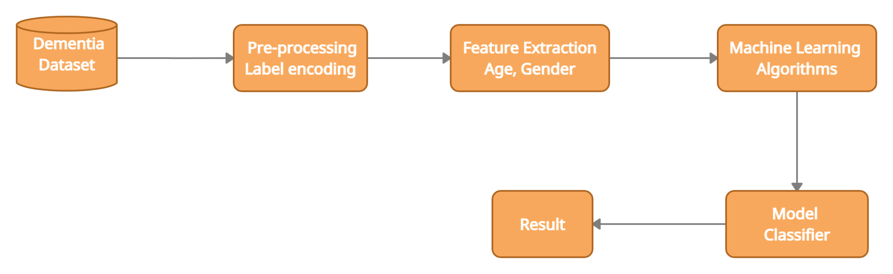
SYSTEM ARCHITECTURE

Slide 20
MODULES
Data Collection
Pre-processing of data
Feature Extraction
Classification of data
Evaluation of Model

Slide 21
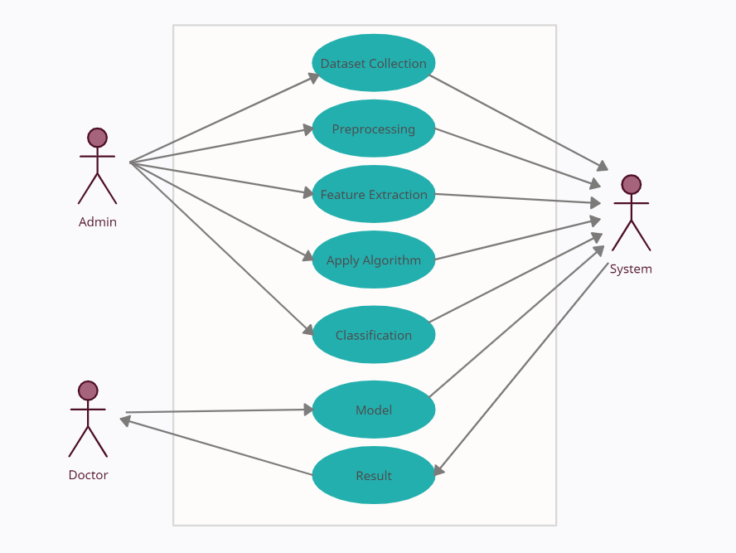
USE CASE DIAGRAM

Slide 22
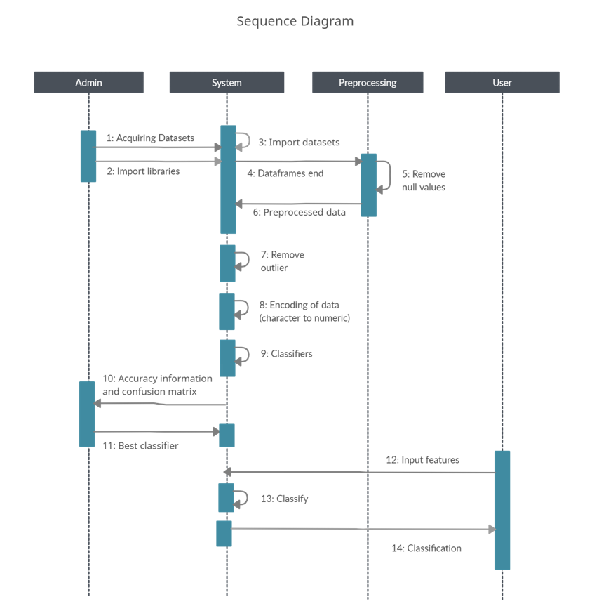
SEQUENCE
DIAGRAM

Slide 23
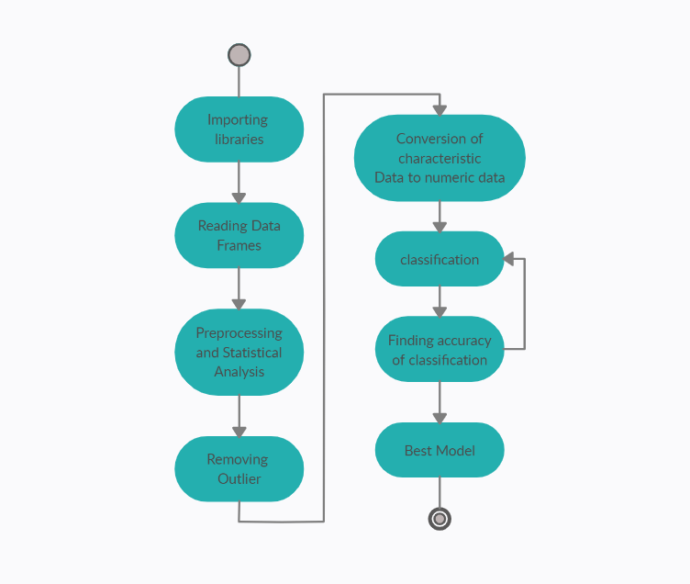
ACTIVITY DIAGRAM

Slide 24
IMPLEMENTATION
Following methods are used:
Random Forest classifier
Support Vector Machine
Decision Tree Classifier
XGBOOST
Voting classifier
LGBM Classifier
Extra Trees Classifier
Gradient Boosting classifier
Adaboost Classifier
K Neighbours Classifier
MLP Classifier
Gaussian NB
Logistic Regression

Slide 25
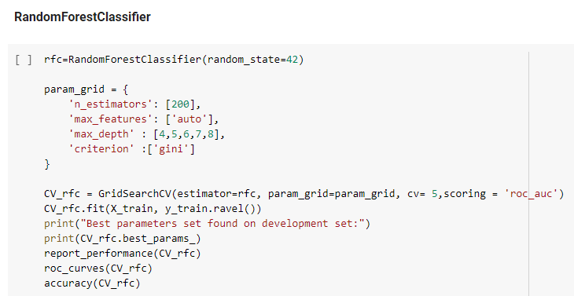
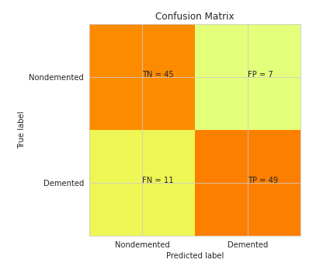
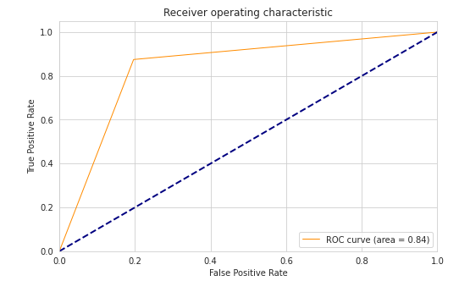
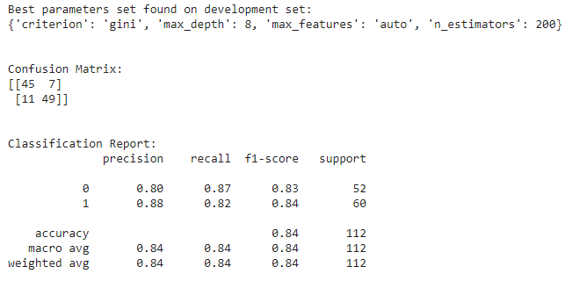
Accuracy : 83.92%

Slide 26
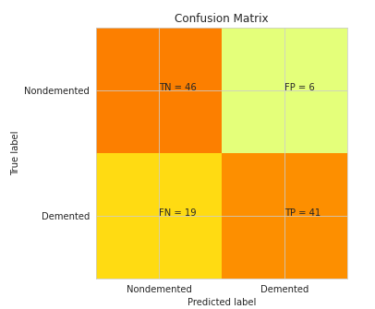
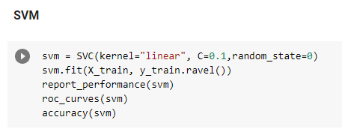
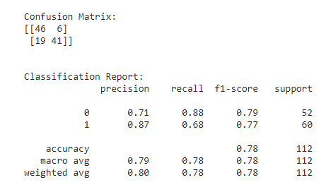
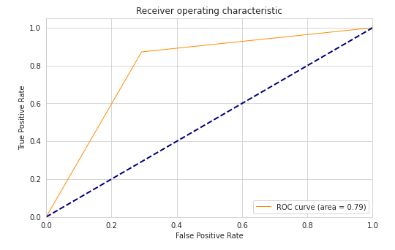
Accuracy:77.67%

Slide 27
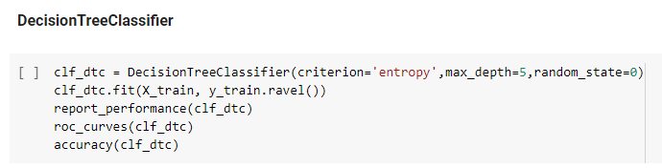
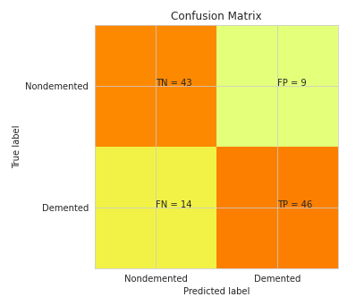
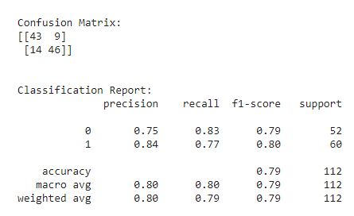
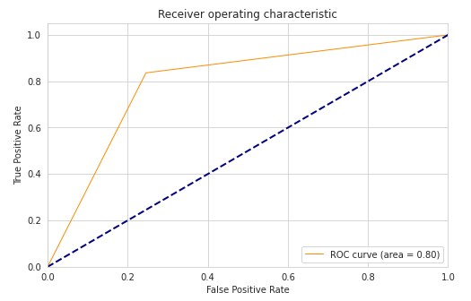
Accuracy: 79.46%

Slide 28
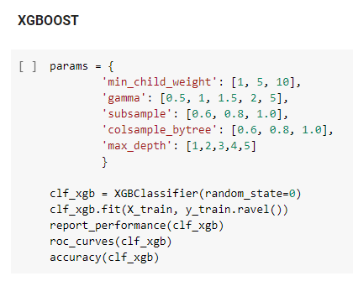
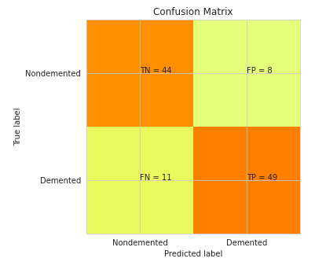
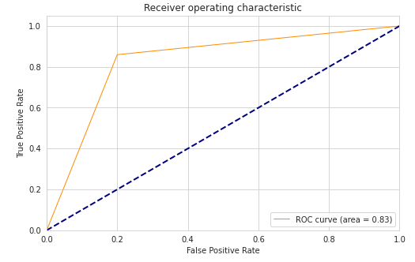
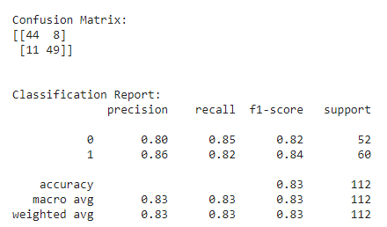
Accuracy:83.03%

Slide 29
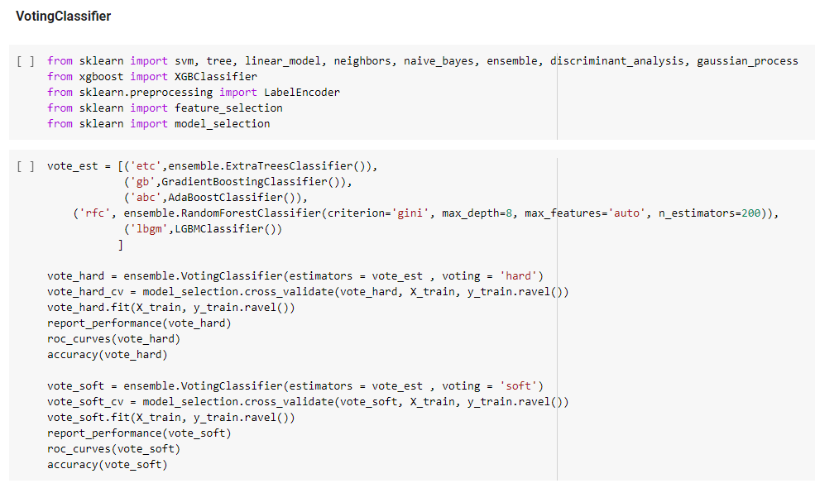

Slide 30
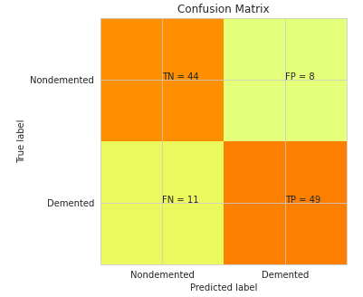
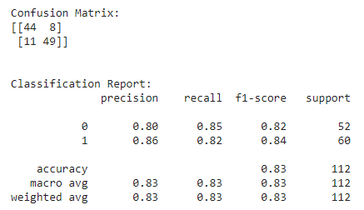
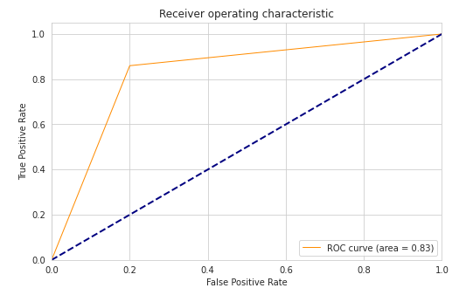
Accuracy :83.03%

Slide 31
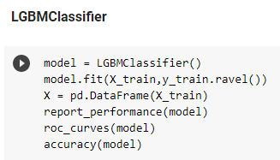
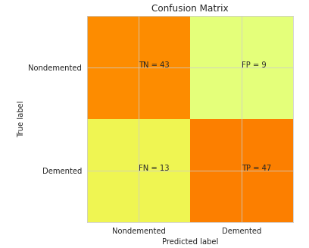
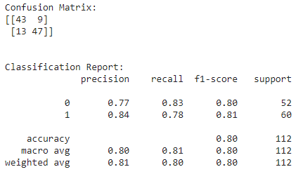
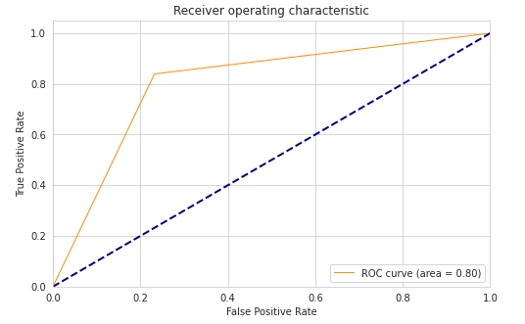
Accuracy:80.35%

Slide 32
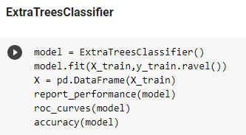
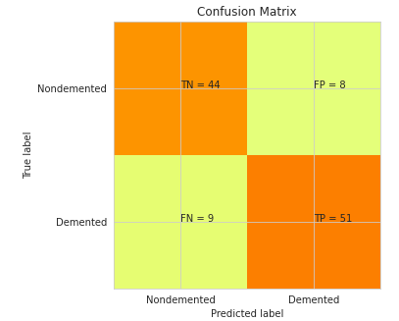
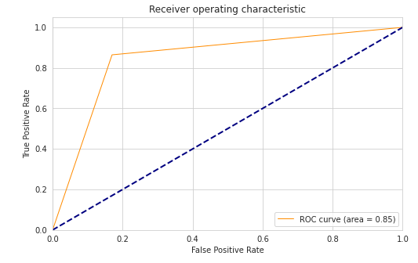
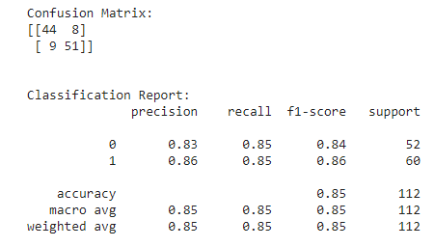
Accuracy:84.82%

Slide 33
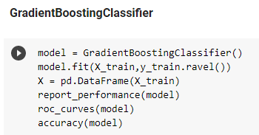
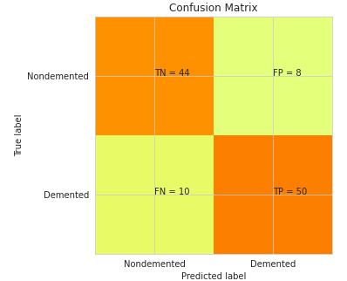
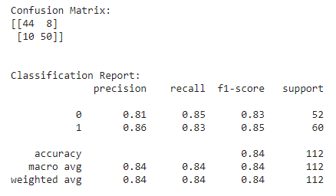
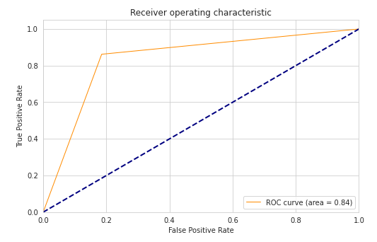
Accuracy:83.92%

Slide 34
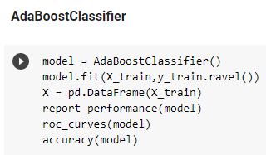
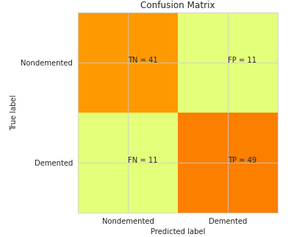
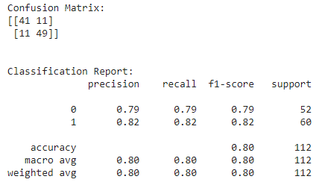
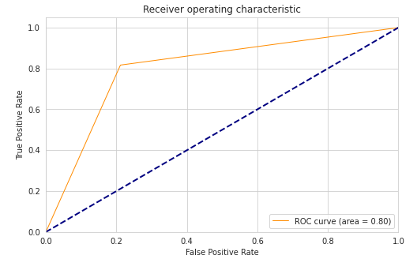
Accuracy:80.35%

Slide 35
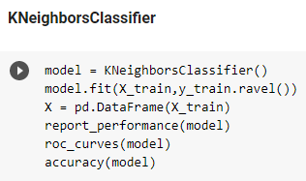
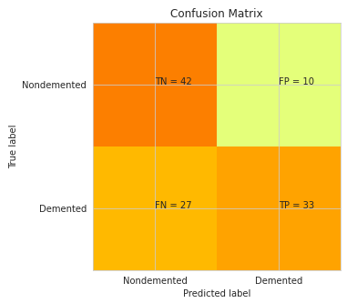
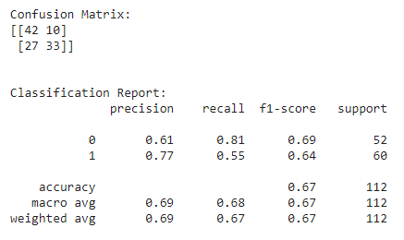
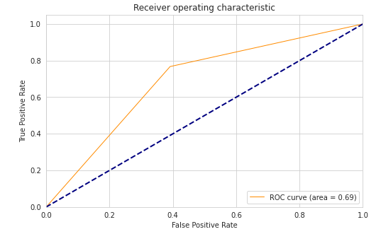
Accuracy:66.96%

Slide 36
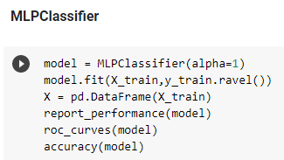
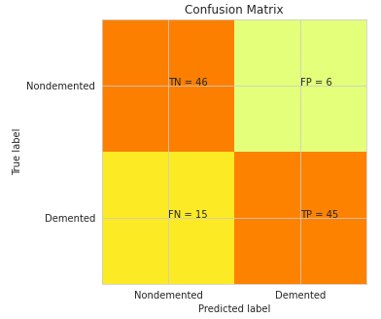
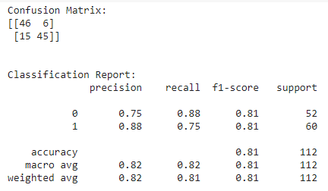
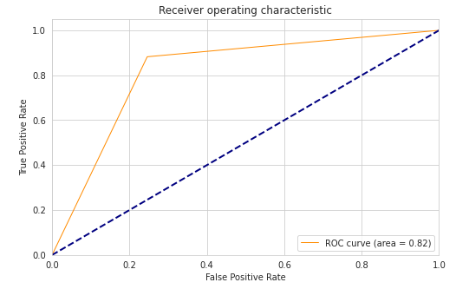
Accuracy:81.25%

Slide 37
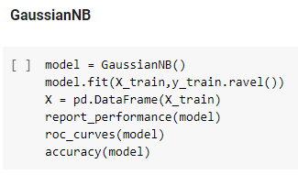
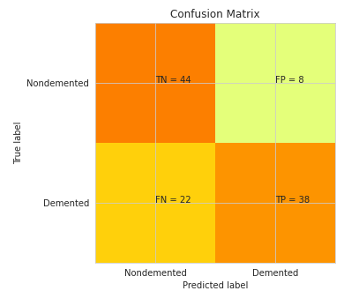


Accuracy:73.21%

Slide 38




Accuracy:73.21%

Slide 39
RESULT
Several models have been used to predict the test values. Using the test set and predicted values, accuracies of each of these models are calculated.
While each classifier predicts whether a test subject has dementia or not, to some extent, the model with the highest accuracy is chosen for further implementation. The obtained accuracies of all the models are plotted on a graph to provide a diagrammatic representation.
The ExtraTreesClassifier has shown the highest accuracy of 0.857 among all the considered models.

Slide 40
RESULT
DESCRIPTION OF TESTCASE | RESULT
All input data fields are properly filled | Pass
No input data is provided leaving all the fields empty | Fail
Partial data fields are filled | Pass
Input data is of type String | Invalid
Input data is of type Float | Pass
‘Gender’ field filled with values other than 0 or 1 | Invalid

Slide 41

RESULT

Slide 42
CONCLUSION
Dementia, being a syndrome that affects memory, can not be cured but its symptoms can be reduced. In order to act upon this syndrome, dementia needs to be identified in the test subject first. This was achieved with the help of the proposed model.
The model classifies whether a test subject has dementia or not based on several features of the subject. This model has displayed an accuracy of 84.82%, after successfully overcoming various challenges such as complex neural networks image analysis and less amount of available data.
This classification can help in identifying the syndrome and treating it as soon as possible.

Slide 43
FUTURE SCOPE
The primary aim of the proposed model is to identify dementia in a subject based on its several features. This aim was realized by the presented classifier.
Along with the resulting classifications, MRI images of the brain can be utilized to arrive at a definite conclusion. This can be advanced further with the help of medical experts.
Furthermore, the available and acquired data can be used to treat patients in a more effective way focusing on deprived areas. In addition to this, patterns between the data can be identified and understood in order to prevent the hereditary passage of the syndrome, to a certain extent.

Slide 44
REFERENCES
Dementia
[1] G. M. McKhann et al., "The diagnosis of dementia due to Alzheimer’s disease: Recommendations from the National Institute on aging-Alzheimer’s association workgroups on diagnostic guidelines for Alzheimer’s disease", Alzheimer’s Dementia, vol. 7, pp. 263-269, 2011.
[2] K. S. Santacruz and D. Swagerty, "Early diagnosis of dementia", Amer. Family Phys., vol. 63, no. 4, pp.703-713, 2001.
[3] https://www.who.int/news-room/fact-sheets/detail/dementia
[4] https://www.webmd.com/alzheimers/types-dementia
Dementia Detection Methods
[5] https://www.alz.org/alzheimers-dementia/what-is-dementia#:~:
text=Dementia%20is%20a%20general%20term,most%20common%20cause%20of%20dementia.
[6] Panch T, Szolovits P, Atun R. Artificial intelligence, machine learning and health systems. J. Glob. Health. 2018;8(2):020303. [PMC free article] [PubMed] [Google Scholar]

Slide 45
REFERENCES
[7] Brauser, D.: ‘Machine Learning’ Tool May Predict Dementia Development Up to 10 Years Later. Medscape (2016)
[8] Goodfellow, I., Bengio, Y., and Courville, A. (2016). Deep Learning. Cambridge, MA: The MIT Press.
[9] Pellegrini, E., Ballerini, L., Hernandez, M. D. C. V., Chappell, F. M., González-Castro, V., Anblagan, D., et al. (2018). Machine learning of neuroimaging for assisted diagnosis of cognitive impairment and dementia: a systematic review. Alzheimers Dement. 10, 519–535. doi: 10.1016/j.dadm.2018.07.004
[10] Nello Cristianini and Bernhard Scholkopf. 2002. Support vector machines and kernel methods: the new generation of learning machines.AiMagazine23, 3 (2002), 31–31 .
[11] David Glenn Clark, Paula M McLaughlin, Ellen Woo, Kristy Hwang, Sona Hurtz, Leslie Ramirez, Jennifer Eastman, Reshil-Marie Dukes, PuneetKapur, Thomas P DeRamus, et al.2016. Novel verbal fluency scores and structural brain imaging for prediction of cognitive outcome in mildcognitive impairment.Alzheimer’s & Dementia: Diagnosis, Assessment & Disease Monitoring2 (2016), 113–122 .
[12] X. Liu, D. Tosun, M.W. Weiner, N. Schuff Locally linear embedding (LLE) for MRI based Alzheimer's disease classification Neuroimage, 83 (2013), pp. 148-157

Slide 46

THANK YOU

